Slide 1

DHBW Bad Mergentheim
Modul: Marketing
Members:
Yailyn Duarte
Enni Anjeh
Nico Kemper
Andreas Litt
3.11.2022

Slide 2
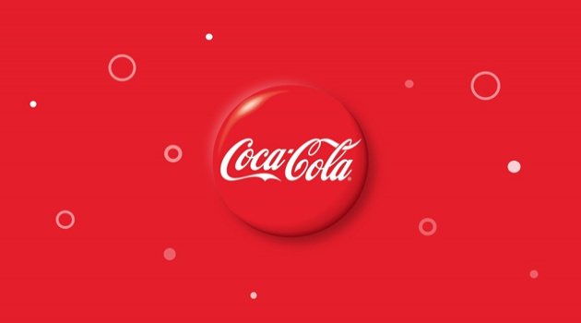

Slide 3


Slide 4
Market Segmentation
Segmentation:
Bases (and Variables) used :
Geography (mainly Countries)
Demographics (Age)
Psychographics (lifestyle : healty life → diet coke)
Targeted Segments:
Everyone, but mainly Teenagers young adults
All countries, except Cuba Russia North Corea
Targeting Strategy :
Differentiated Targeting Strategy
Adapt to market requirements (e.g. US-Market : bigger bottles because they have bigger fridges)
Adapt to „seasons“ (different Marketing around Christmas than in Summer)
some material is used all over the glob/all year

Slide 5
Positioning
How does Coca-Cola position itself?
Joy/Happiness bringing → show moments that everybody has experienced happiness in (with friends)
Sociable/family-friendly → advertisments show group of friends or happy family
More than a drink/Coca Cola as a Lifestyle → advertise with slogans like „Real Magic“ ; show active people
Refreshing → use the „ahhh“-sound
High quality (relative to other softdrinks)
Affordable/available
Socially progressive → present themselves as open/inclusive/integrating (super bowl ads promoting equality)
Positioning Variables:
Trustworthiness
Taste/quality
Affordability
Availability
Social progessivism

Slide 6
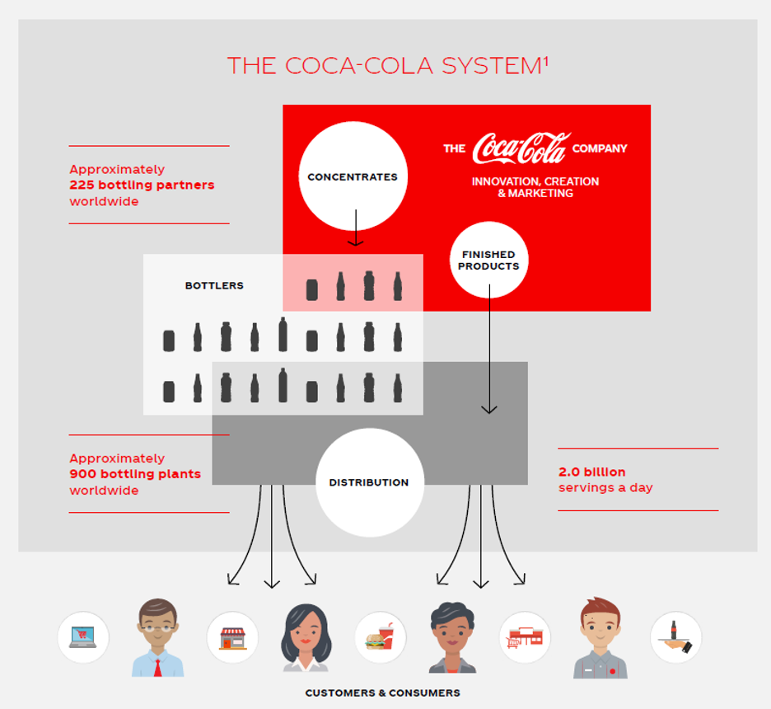
2.0 billion products every day Global business on a local scale CocaCola sells concentrates Botteling partners manufacture and distribute
Place - Distribution
Why?
Product does not travel far

Slide 7
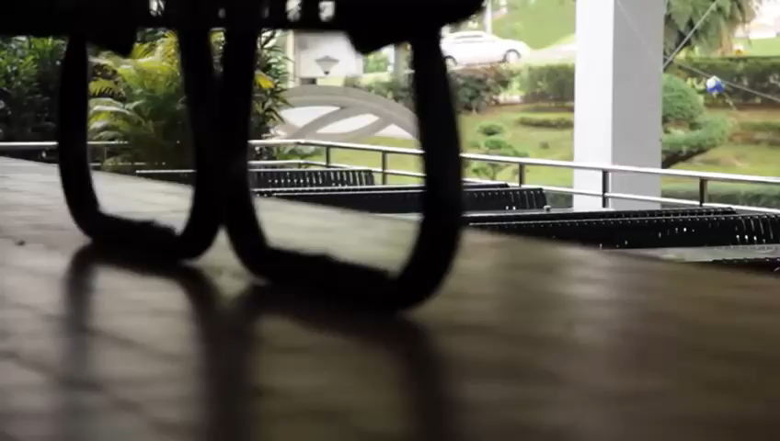

Slide 8
